Slide 1
AZ-400.00 Learning Path 06: Implement security and validate code bases for compliance

Slide 2
Agenda
Module 01: Introduction to Secure DevOps.
Module 02: Implement open-source software.
Module 03: Software Composition Analysis.
Module 04: Security Monitoring and Governance.
Labs & Learning Path review and takeaways.
Notes:
By the end of this module, you’ll be able to:
Design a report, including report layout, adding built-in and custom visuals, and adding basic report functionality.
Enhancing a report, including improving performance, adding navigation and interactions, and implementing buttons and bookmarks.

Slide 3
Module 01: Introduction to Secure DevOps

Slide 4
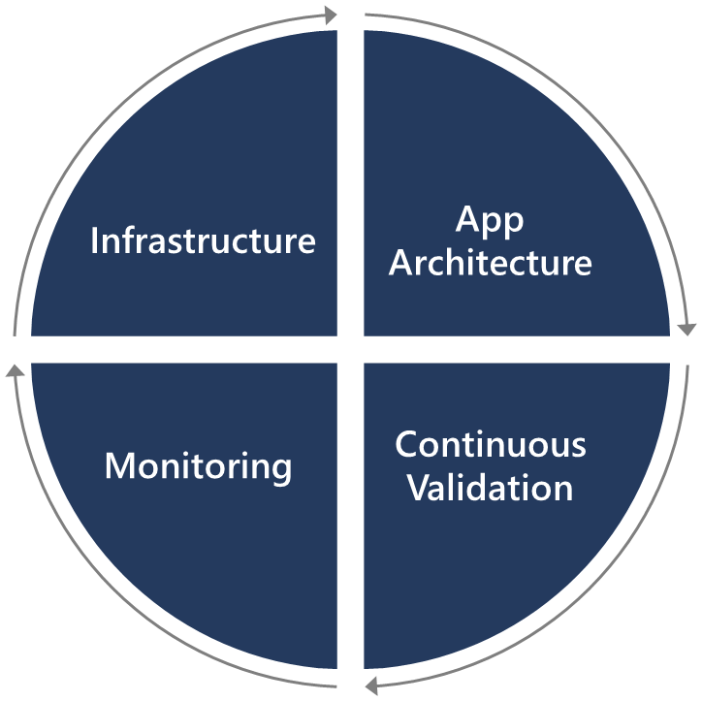
Introduction
Security is everyone’s responsibility.
Securing applications is a continuous process that encompasses the following:
Secure infrastructure
Designing an architecture with layered security
Continuous security validation
Monitoring for attacks

Slide 5
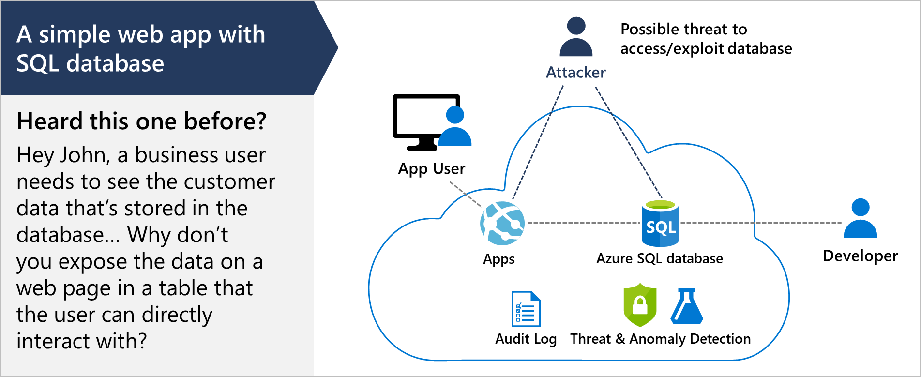
Describe SQL injection attack

Slide 6
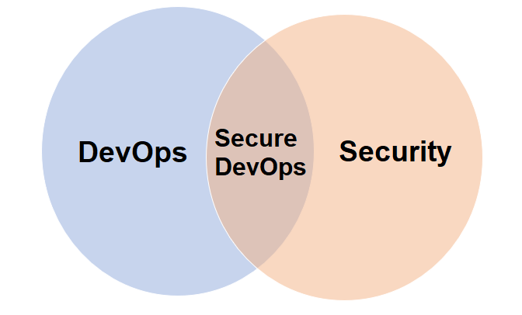
Understand DevSecOps
Secure DevOps is a set of practices designed to integrate DevOps and security
The goal is to enable development teams to work fast without introducing unwanted vulnerabilities
Security strategy includes access control, environment hardening, perimeter protection, and more
Secure DevOps is also sometimes referred to as DevSecOps
Notes:
Secure DevOps includes bigger questions such as:
Is my pipeline consuming third-party components, and if so, are they secure?
Are there known vulnerabilities within any of the third-party software we use?
How quickly can I detect vulnerabilities (time to detect)?
How quickly can I remediate identified vulnerabilities (time to remediate)?

Slide 7
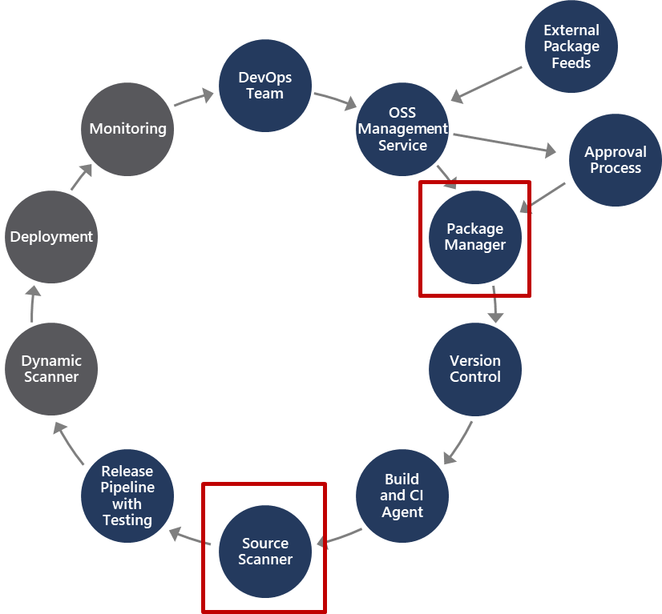
Explore Secure DevOps pipeline
Package management, and the approval process associated with it, accounts for how software packages are added to the pipeline, and the approval process they need to go through
Source scanner is for performing a security scan to verify certain security vulnerabilities are not present in our application source code
Notes:
There are two important areas in the pipeline that are part of Secure DevOps and not other DevOps pipelines. Notice these two areas are in different parts of the pipeline.

Slide 8
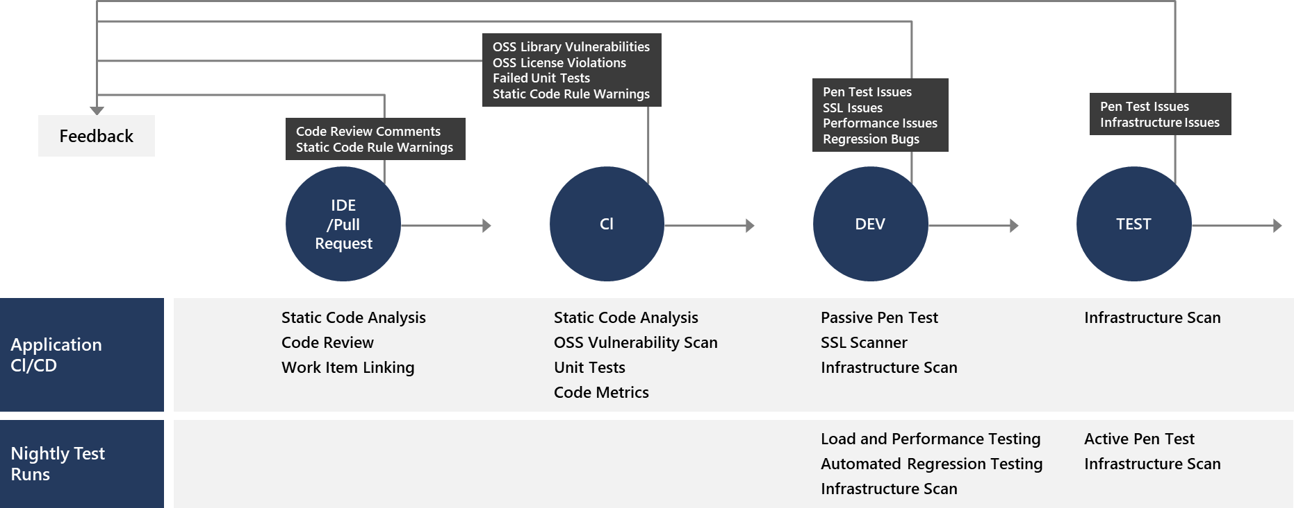
Explore key validation points
Continuous security validation should be added at each step from development through production

Slide 9
Explore continuous security validation
Coding
Build
QA & security
Production
$80/defect
$240/defect
$960/defect
$7,600/defect
Source: Ponemon Institute Research
Reduce cost by moving Secure DevOps to the left
Use automated tooling and processes to identify problems

Slide 10
Module 02: Implement open-source software

Slide 11
Explore how software is built
1
Software based 80% on components:
Internal teams
Commercial 3rd party
Open-source community
Almost all software nowadays uses open-source software in some way, shape, or form
2

Slide 12



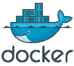



















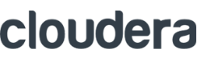

What is open-source software?
“Open-source software is a type of computer software in which source code is released under a license in which the copyright holder grants users the rights to study, change, and distribute the software to anyone and for any purpose.”
Enable
open-source use cases in the cloud
Integrate
open-source technologies in our platform
Release
innovative technologies as open source
Contribute
to the open-source ecosystem
Draft
R Server
.NET Core
CNTK
Brigade
TypeScript
F#
PowerShell
ACS Engine
Graph Engine
Visual Studio Code
Office UI Fabric
SONiC
+
ECOSYSTEM
https://en.wikipedia.org/wiki/Open-source_software
Notes:
Discuss open-source and how we support it in Azure, GitHub and Azure DevOps.
https://azure.microsoft.com/en-us/overview/open-source
https://en.wikipedia.org/wiki/Open-source_software

Slide 13
Explore corporate concerns with open-source software components
1
It may have low quality:
This would impact maintainability, reliability, and performance of the overall solution
2
It may have no active maintenance:
The code would not evolve over time or be alterable without making a copy of the source code, effectively forking away from the origin
It could contain malicious code:
The entire system that includes and uses the code will be compromised. Potentially the entire company’s IT and infrastructure is affected
3
4
It may have security vulnerabilities:
The security of a software system is as good as its weakest part. Using source code with vulnerabilities makes the entire system susceptible to attack by hackers and misuse
5
It may have unfavorable licensing restrictions:
The effect of a license can affect the entire solution that uses the open-source software
Notes:
Make it clear that OSS is like all code. It could potentially have issues, but with active community support, it tends to resolve faster than others. You can emphasize both the benefits and challenges. It provides potential and capabilities. We need to make the DevOps teams aware about the challenges and know the potential risks.

Slide 14
Explore common open-source licenses
Restrictive
ATTRIBUTION
BSD
MIT
Apache
DOWNSTREAM
MPL
EPL
MS-RL
COPYLEFT
GPL
LGPL
AGPL
Permissive

Slide 15
Module 03: Software Composition Analysis

Slide 16
Inspect and validate code bases for compliance
There are many aspects to building and deploying secure applications
1
General knowledge problem
2
Code is created correctly and securely implements the required features, and we need to make sure that the features were designed with security in mind in the first place
3
Complies with the rules and regulations that it is required to meet

Slide 17
Explore software composition analysis (SCA)
Package Management:
Unique source of binary components
Create a local cache of approved components
Use Azure Artifacts to share and organize your packages
Package types: NuGet, npm, Maven, Gradle, Universal, and Python
Open-Source Software (OSS) Components:
Reused dependencies can have security vulnerabilities
Ensure you have the latest version
Check for the correct binaries
Promptly address vulnerabilities
Analyzing the software to determine its composition can help mitigate potential vulnerabilities
Scanning tools discussed in the next Learning Path

Slide 18
Implement GitHub Dependabot alerts and security updates
1
Check for updates
2
Alerts
3
Automated pull requests
4
Review and triage

Slide 19
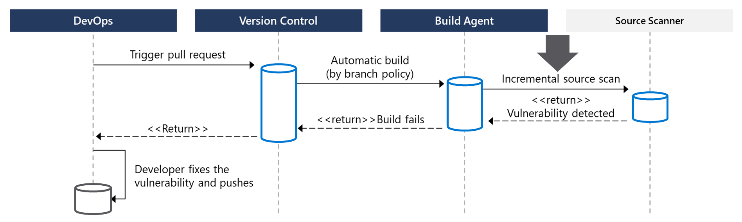
Integrate software composition analysis checks into pipelines
Pull requests are the way DevOps teams submit changes
Mend, Checkmarx, Veracode, and Black Duck by Synopsis can facilitate incremental scans
Integrate scanning into a team’s workflow at multiple points along the path

Slide 20
Examine tools for assess package security and license rate
Approach 1: Scan centralized artifact repository
Approach 2: Tooling during build in pipeline
Tool | Type
Artifactory | Artifact repository
SonarQube | Static code analysis tool
Mend Bolt | Build scanning

Slide 21
Module 04: Security Monitoring and Governance

Slide 22
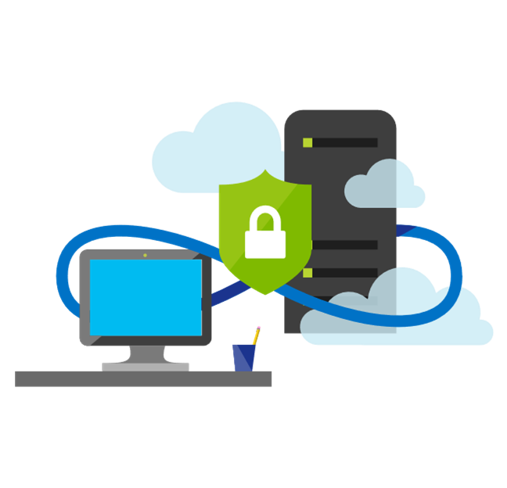
Implement pipeline security
Use traditional operational methods for protecting identities and assets
Authentication and Authorization: Use Multi-Factor Authentication and Just enough Admin (JEA)
Use the CI/CD release pipeline: Use immutable infrastructure and only using your pipeline
Manage Permissions: Secure the pipeline using RBAC
Dynamic Scanning: Test running apps, such as penetration testing
Notes:
To improve security in general use Azure Resource Manager templates, or other code-based configurations, and Infrastructure as Code best practices, such as only making changes in templates, thereby making them traceable and repeatable. Also, use provisioning and configuration technologies such as Desired State Configuration, Azure Automation, and other third-party tools and products that integrate seamlessly with Azure.

Slide 23

Explore Microsoft Defender for Cloud
Provide security recommendations
Monitor all your services
Analyze and identify potential attacks
Supports Windows and Linux operating systems
Monitor security settings
Use Azure Machine Learning
Provide just-in-time (JIT) access control
Available in two pricing tiers

Slide 24
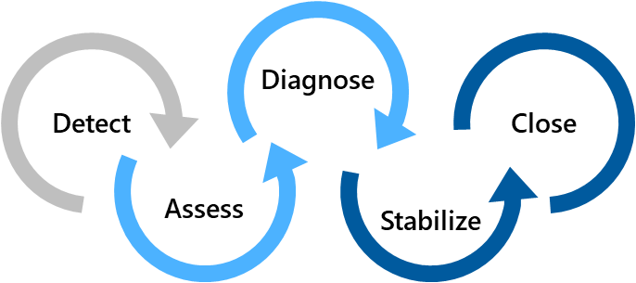
Examine Microsoft Defender for Cloud usage scenarios
Scenario 1
Scenario 2
Use Microsoft Defender for Cloud for an incident response
Use Microsoft Defender for Cloud recommendations to enhance security
Security Policy
Recommendations
Detect – Verify a high security alert was raised
Access – Obtain information about the alert
Configure a security policy
Diagnose – Follow the remediation steps
Implement the recommendations for the security policy
Notes:
Scenario 1:
Many organizations learn how to respond to security incidents only after suffering an attack. To reduce costs and damage, it’s important to have an incident response plan in place before an attack occurs. You can use Microsoft Defender for Cloud in different stages of an incident response.
You can use Microsoft Defender for Cloud during the detect, assess, and diagnose stages.
- Detect: Review the first indication of an event investigation. Example: Use the Microsoft Defender for Cloud dashboard to review the initial verification that a high-priority security alert was raised.
- Assess: Perform the initial assessment to obtain more information about the suspicious activity. Example: Obtain more information about the security alert.
- Diagnose: Conduct a technical investigation and identify containment, mitigation, and workaround strategies. Example: Follow the remediation steps described by Microsoft Defender for Cloud in that particular security alert.
Scenario 2:
You can reduce the chances of a significant security event by configuring a security policy, and then implementing the recommendations provided by Microsoft Defender for Cloud.
A security policy defines the set of controls that are recommended for resources within that specified subscription or resource group. In Microsoft Defender for Cloud , you define policies according to your company's security requirements.
Microsoft Defender for Cloud analyzes the security state of your Azure resources. When Microsoft Defender for Cloud identifies potential security vulnerabilities, it creates recommendations based on the controls set in the security policy. The recommendations guide you through the process of configuring the needed security controls

Slide 25


Explore Azure Policy
Is a service in Azure that you use to create, assign, and manage policies
Provides enforcement by using policies and initiatives
Runs evaluations on your resources and scans for those not compliant
Comes with several built-in policy and initiative definitions
Integrates with Azure DevOps by applying any continuous integration (CI) and continuous deployment (CD) pipeline policies
An example of an Azure policy that you can integrate with your DevOps pipeline is the Check Gate task
Notes:
Azure Policy Check Gate - https://docs.microsoft.com/en-us/azure/devops/pipelines/tasks/deploy/azure-policy-check-gate?view=vsts

Slide 26
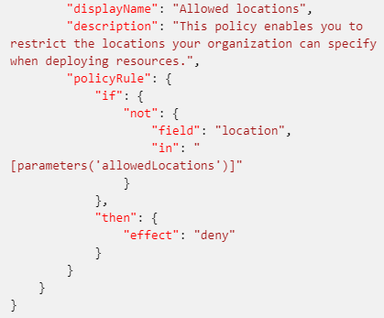
Understand policies
A policy definition expresses what to evaluate and what action to take
Policies are defined in JSON
Assign policies using Azure Portal, Azure CLI, or Azure PowerShell
Use remediation for non-compliant resources
The screenshot is a section of a policy file defining allowed locations
Notes:
A policy definition expresses what to evaluate and what action to take. For example, you could prevent VMs from deploying if they are exposed to a public IP address. You also could prevent a particular hard disk from being used when deploying VMs to control costs.
Every policy definition has conditions under which it is enforced, and an accompanying effect that takes place if the conditions are met.
The process of applying a policy to your resources consist of the following steps:
1. Create a policy definition.
2. Assign a definition to a scope of resources.
3. View policy evaluation results.

Slide 27
Explore initiatives
An initiative definition is a set of policy definitions
Helps track your compliance state for a larger goal
Assigned to a specific scope
Reduces the need for individual scope assignments
Initiative Example:
Create an Initiative named “Enable Monitoring In Microsoft Defender for Cloud.” This would provide the following policies:
Monitor unencrypted SQL Database policy definition
Monitor OS vulnerabilities policy definition
Monitor missing Endpoint Protection policy definition
Even if you have a single policy, we recommend using initiatives if you anticipate increasing the number of policies over time

Slide 28
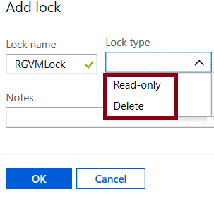
Explore resource locks
Prevent accidental deletion or modification of your Azure resources:
CanNotDelete – Means authorized users can still read and modify a resource, but they can’t delete the resource
ReadOnly – Means authorized users can read a resource, but they can’t delete or update it. Applying this lock is like restricting all authorized users to the permissions granted by the Reader role
In the Azure portal, the locks are called Delete and Read-only respectively

Slide 29
Closing slide

